Slide 1

WEATHER DISEASE
To discuss the issue of global climate and disease

Slide 2
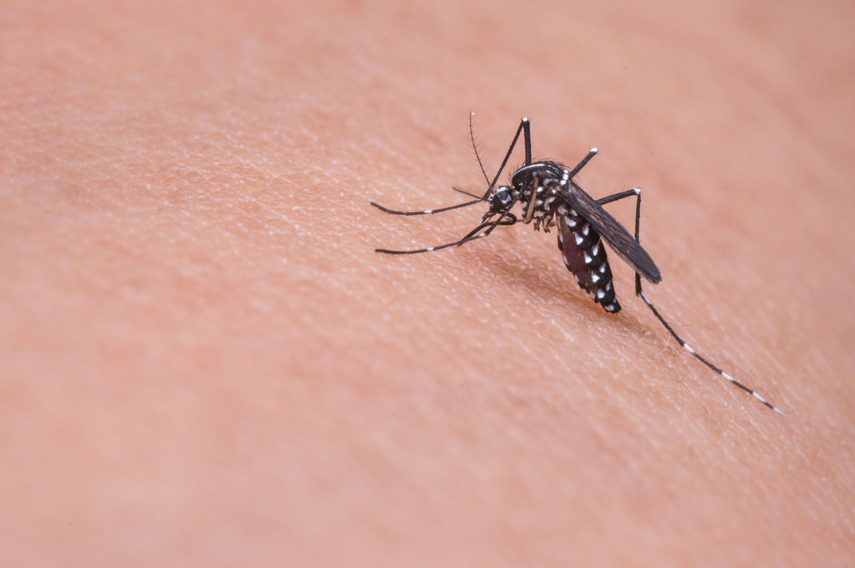
Dengue
Alarm
For Travelers
Show disaster and disease information from global

Slide 3
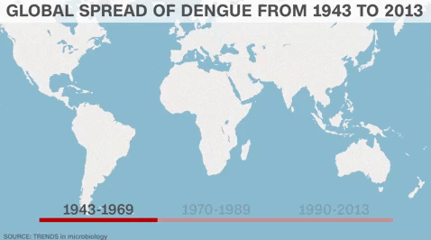
Dengue fever cases are increasing year by year

Slide 4
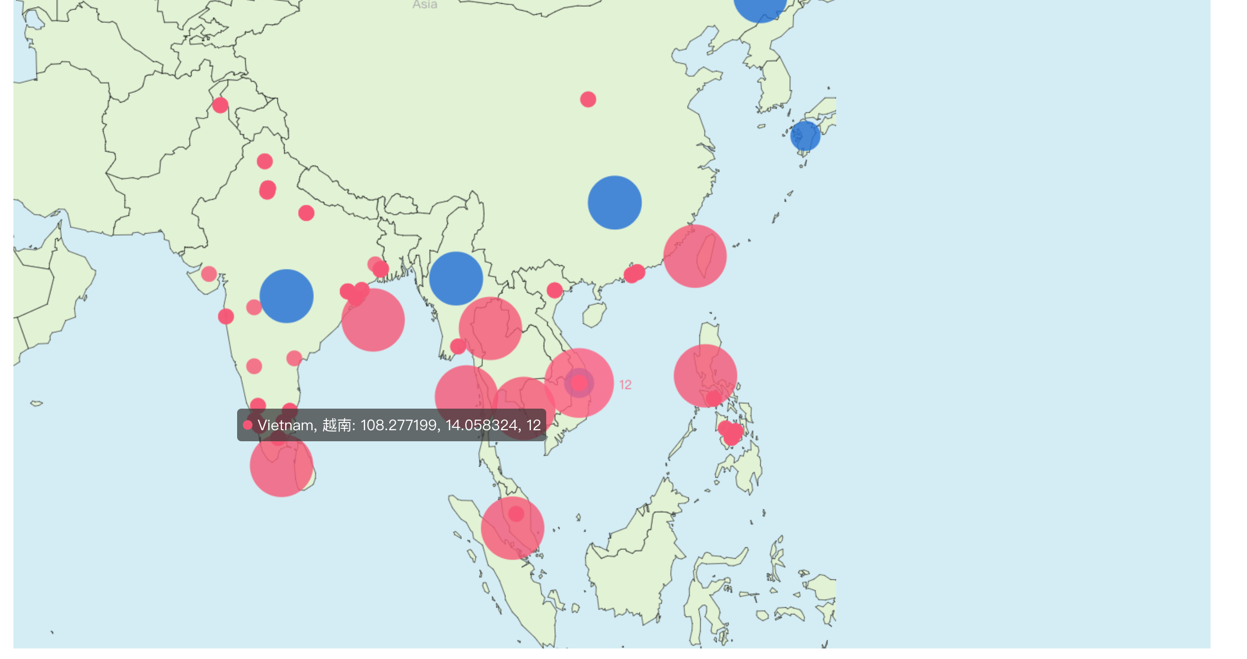
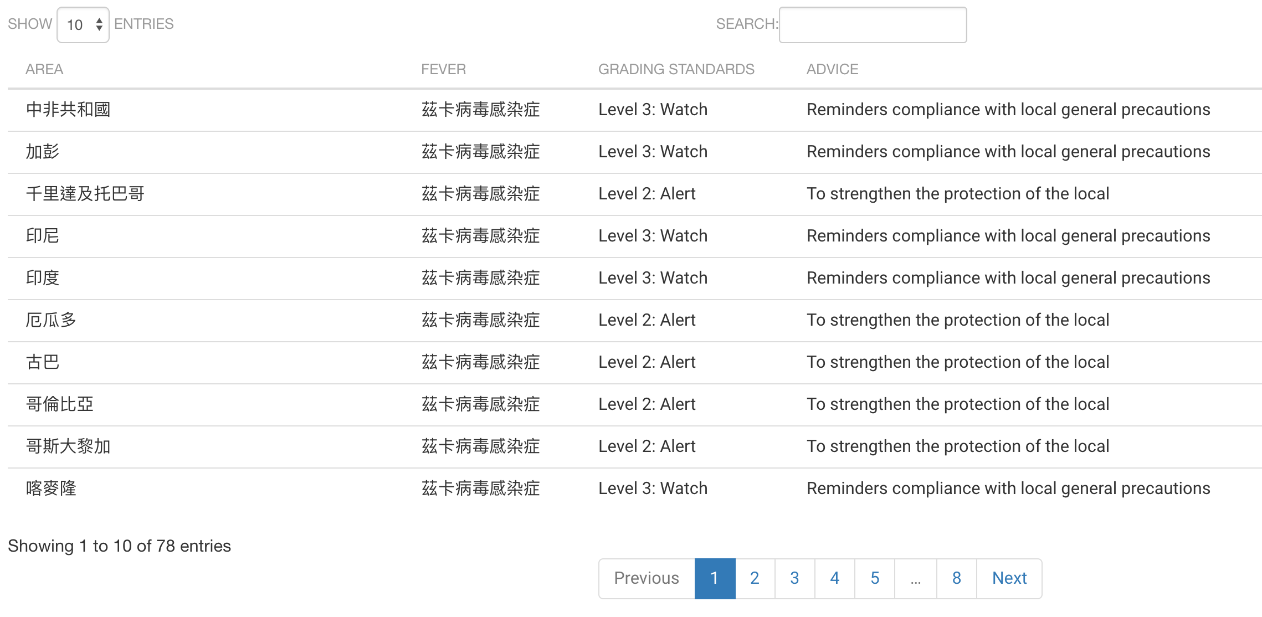
WEB Introduction
Map of disease and disaster alert
table of diease alerm form global

Slide 5
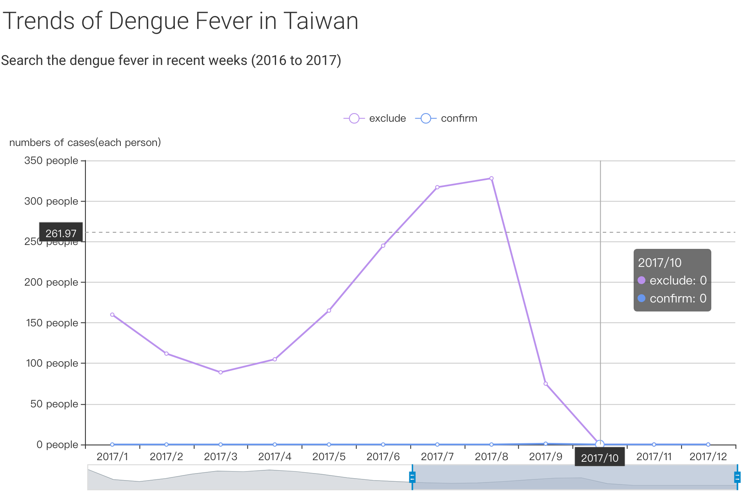
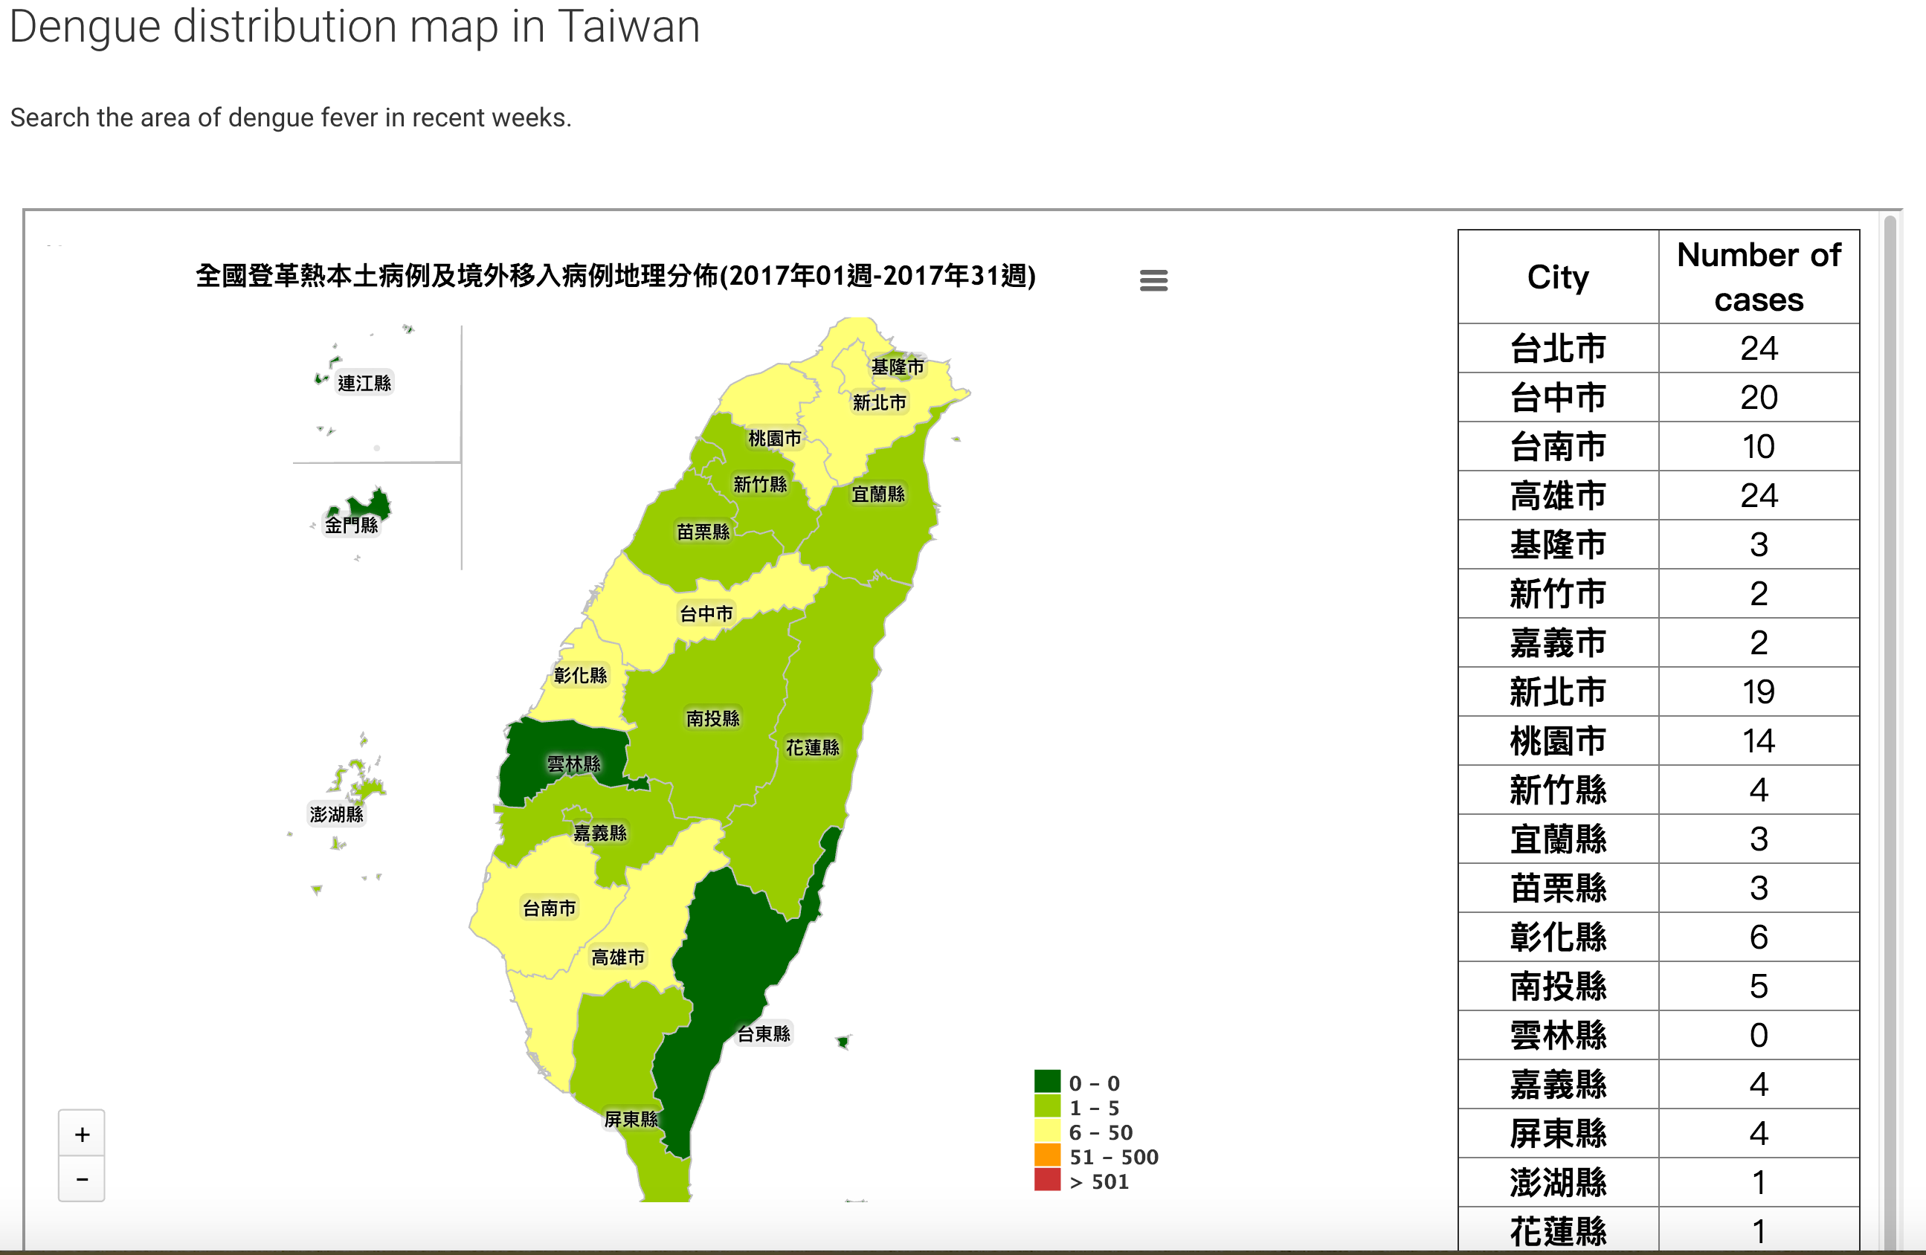
Statistical chart of Dengue cases in Taiwan in recently

Slide 6
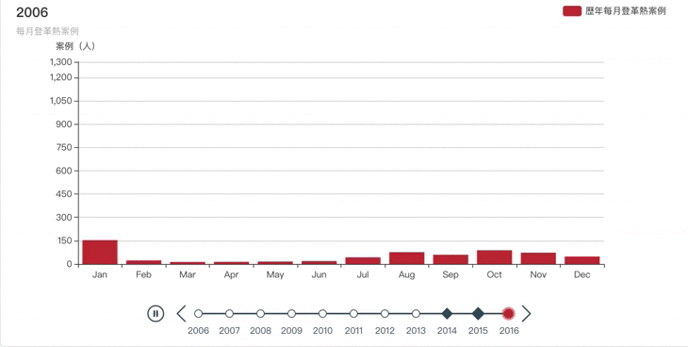
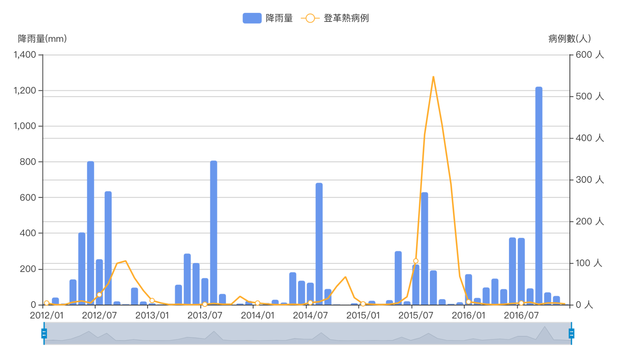
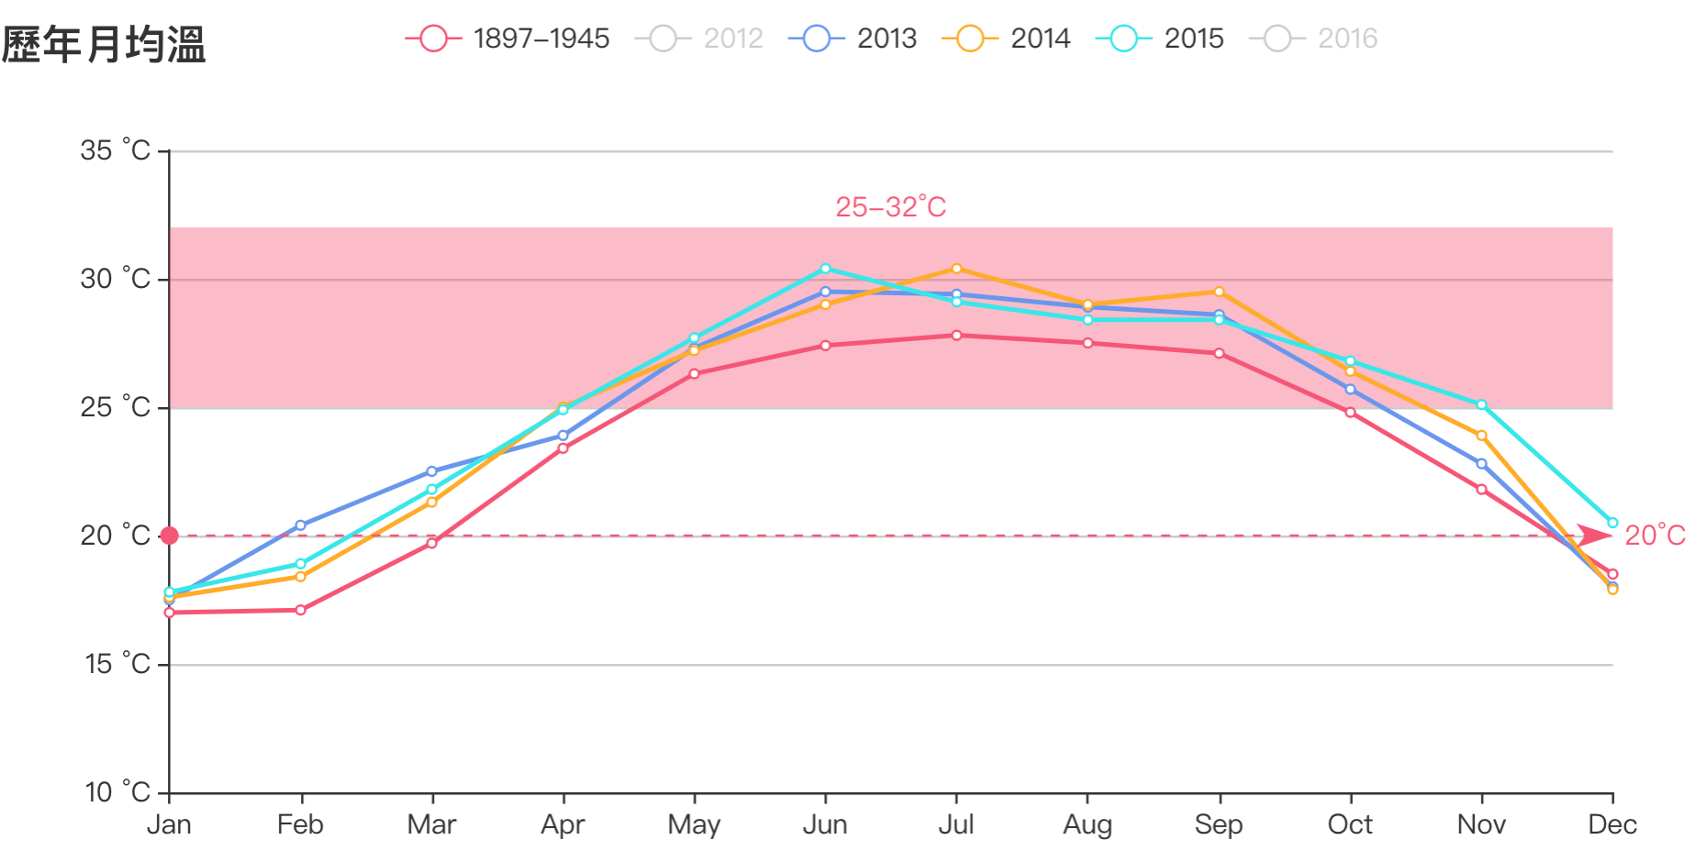
STATISTICS OF DENGUE CASES IN TAIWAN
Statistical chart in Taiwan
COMPARISON CHART OF
DENGUE CASES AND RAINFALL IN TAINAN
COMPARE CHAERT OF MOUTHLY TEMPERATURE IN TAINAN

Slide 7
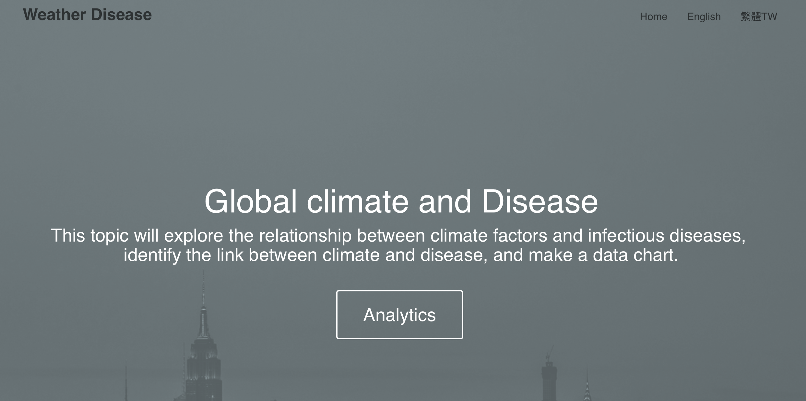
Weather Disease WebSite
URL : http://4xtw.tk

Slide 8
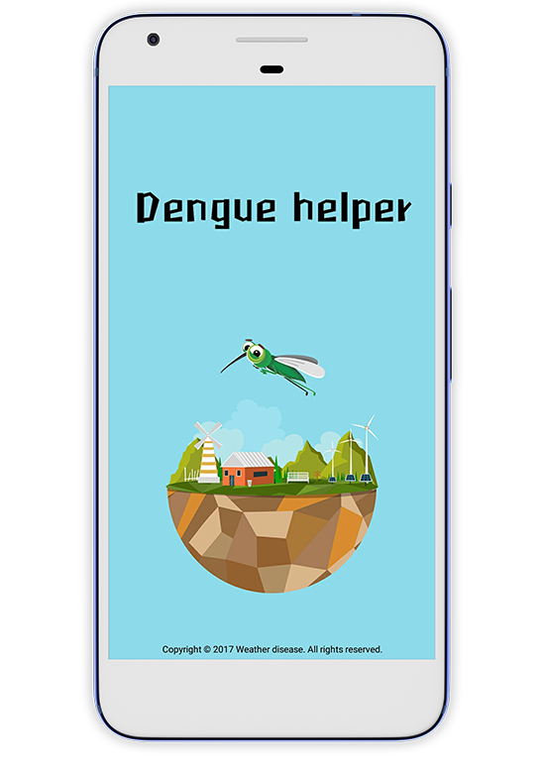

Dengue Helper
Global real-time weather
Real-time disease news.
Global map
Taiwan dengue
Dengue fever prevention

Slide 9

DATASET
Taiwan's Open Data
Taiwan CDC Open Data Portal
Area,Age,Gender Statistics -Dengue
Taiwan CDC News
Central Weather Bureau - open platform
Global Open Data
WHO Disease Outbreak News
International tourism epidemic
recommended level table
Yahoo Weather API

Slide 10

THANK YOU

